Slide 1
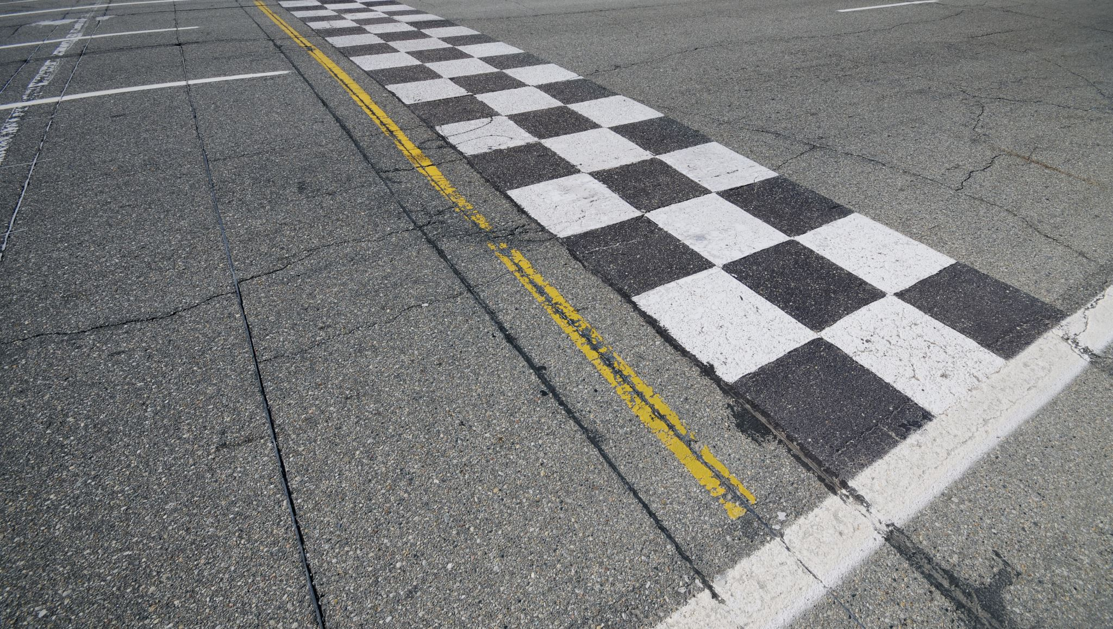
Analysis of traffic violations in Montgomery

Slide 2
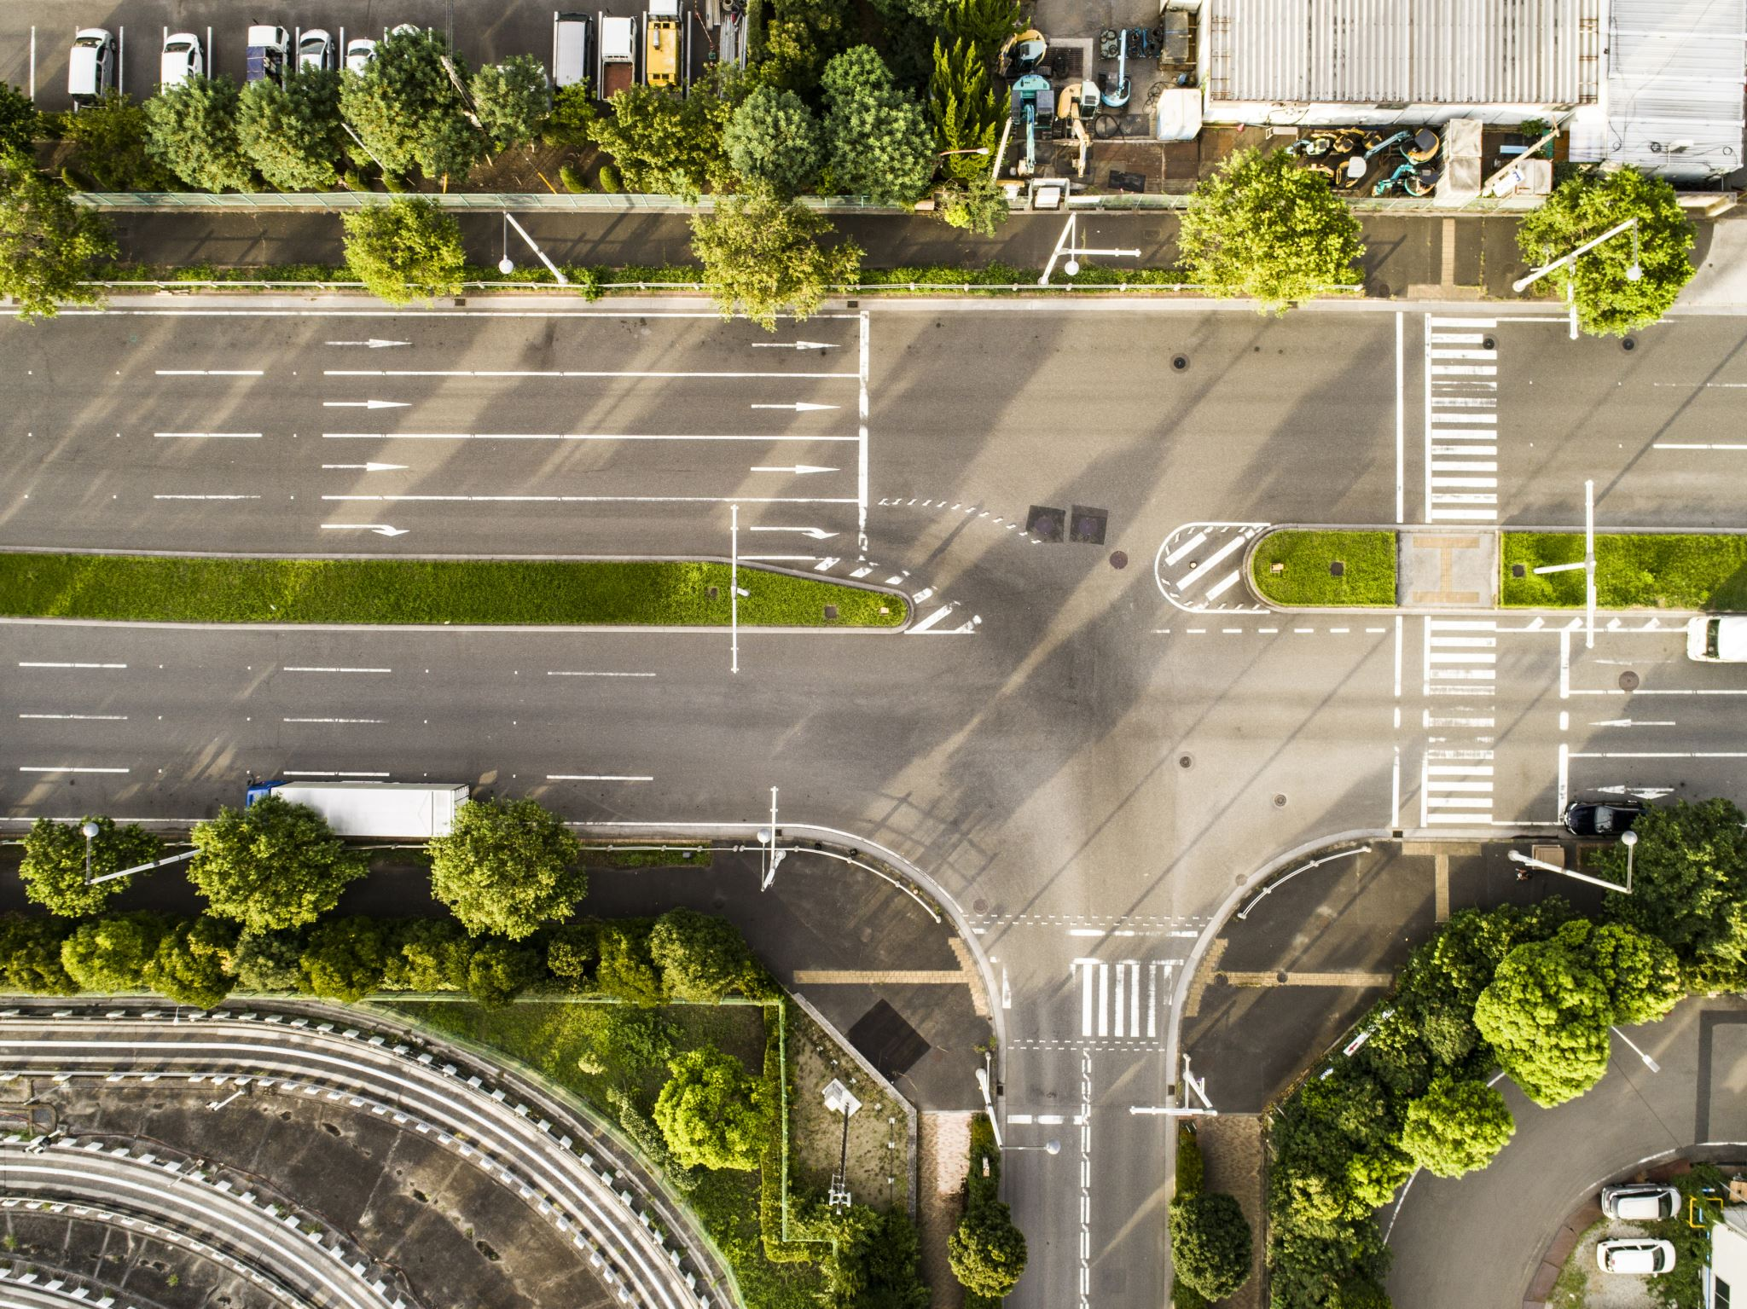
Introduction:
Montgomery County experiences diverse traffic patterns due to its urban-suburban mix.
Traffic violations, from speeding to DUI, impact road safety and accident rates.
Using statistical tests and predictive models, it explores how time, demographics, and enforcement relate to violations.
Montgomery County's detailed dataset offers a strong foundation for improving public safety and traffic management.

Slide 3
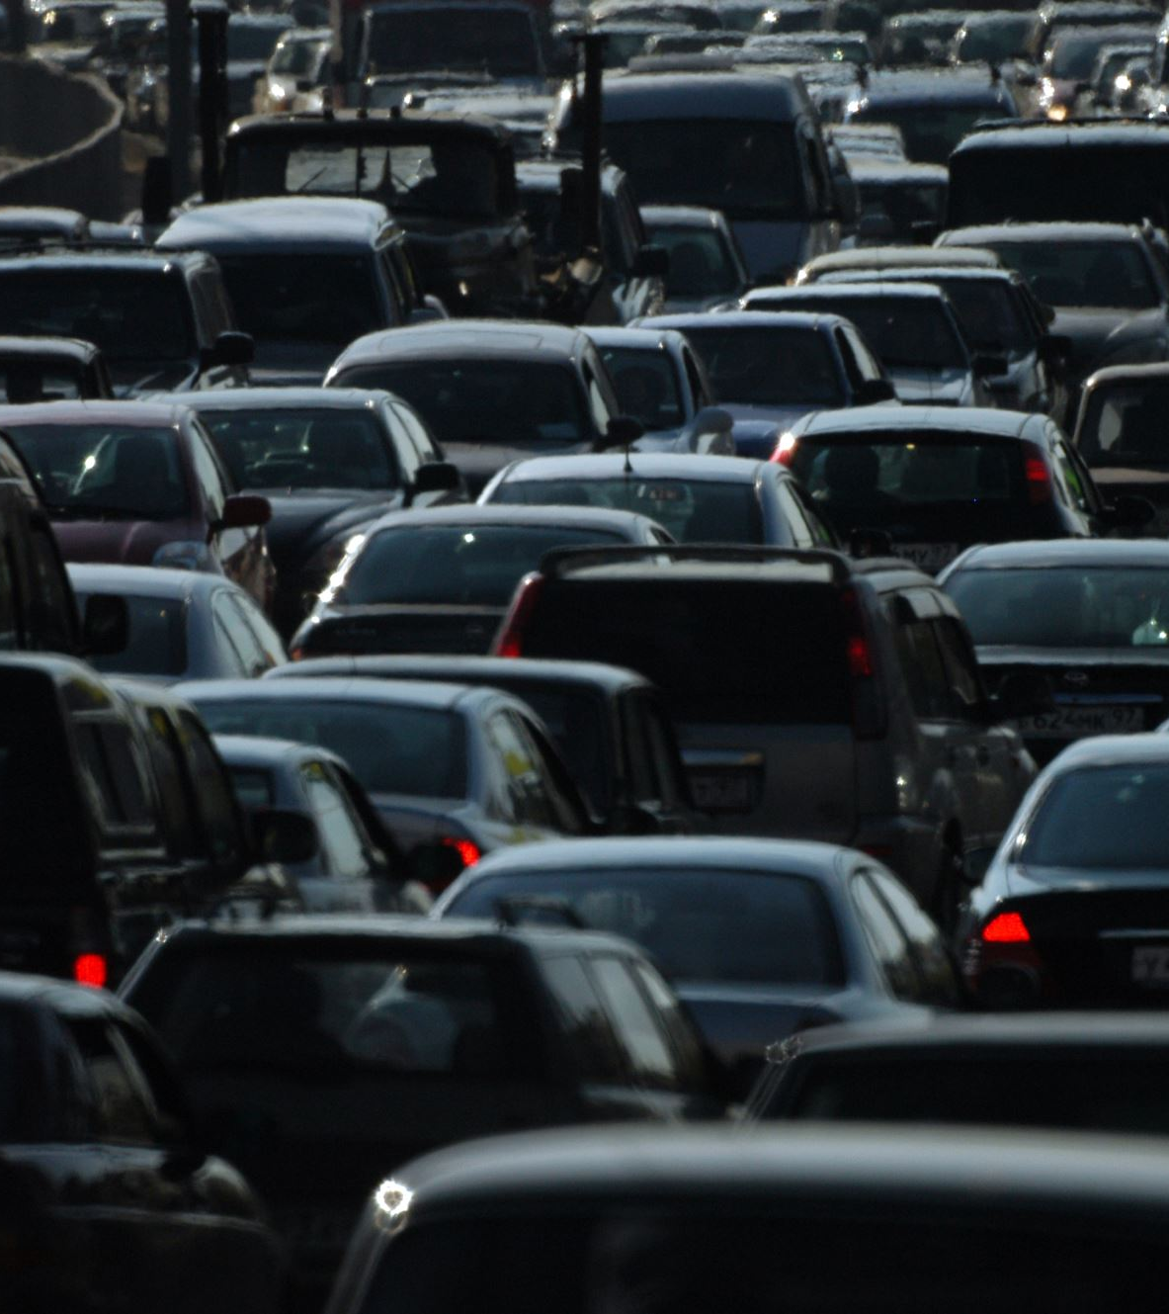
Literature Review
Traffic Violation Patterns and Enforcement Practices
Speeding and DUI are among the most frequent violations and are strongly linked to higher accident rates (Sivasankaran & Balasubramanian, 2021; Ayuso et al., 2010).
Combining high‑risk behaviors such as speeding with passenger or cargo load significantly increases both crash likelihood and severity (Ayuso et al., 2010).
Citations tend to coincide with more severe crashes, suggesting enforcement prioritizes higher‑risk offenses (Aquino et al., 2020).
Temporal & Environmental Influences
Violation frequency peaks during midday hours and on weekends, reflecting heavier traffic flows and leisure travel patterns (Li et al., 2021; Saville et al., 2024).
Adverse conditions low wind speeds, high congestion, cooler temperatures correlate with increased infractions, as drivers engage in riskier behaviors (Li et al., 2021).
Seasonal and holiday trends drive enforcement intensity; predictive resource allocation can target known peak periods (Kumfer et al., 2024). Demographic Disparities & Fairness
Black drivers are stopped and searched at disproportionately higher rates compared to White or Hispanic drivers, evidencing racial disparities in enforcement (Saville et al., 2024; Rababah et al., 2022).
Gender differences appear in violation types: women receive warnings more often, while men incur citations at higher rates (our dataset analysis).
Focusing on objective factors offense seriousness, time/place can mitigate biases and promote equitable enforcement (Saville et al., 2024; Rababah et al., 2022).

Slide 4
Objective:
Analyze
Analyze Violation Patterns: Examine Montgomery County traffic‑stop data to uncover temporal, spatial, and frequency trends in violations.
Assess
Assess Key Drivers: Investigate how violation type, time of day, location, and driver demographics correlate with accident risk and arrest outcomes.
Support
Support Strategic Decisions: Use insights to help hosts make smarter, data-driven listing and pricing strategies.
Data Collection:
Dataset Origin: Retrieved from Data.gov, this Montgomery County traffic‑stop dataset includes over two million records of law enforcement stops.
Time Period: The Dataset Spans January 1, 2012 through December 31, 2024, supporting longitudinal analysis of enforcement trends.
Data Overview:
Record Count: 2,000,127 traffic‑stop records
Variable Count : 52 key fields
Categorical Variables: 37
Numerical Variables: 15

Slide 5
Data Cleaning & Wrangling
Unified Labels: Standardized codes (e.g., “WARN ” to “Warning”, “CIT” to “Citation”) across all categorical fields for clarity.
Smart Imputation:
Low‑missing categoricals filled with mode.
Vehicle Year imputed by Make–Mode median, then overall median.
Search fields (>95% missing) marked “NOT_APPLICABLE” when no search.
Data Cleaning:
Filtered out-of‐county geocoordinates and unrealistic Vehicle Years.
Removed unwanted columns
Set missing DL State = Driver State and if it is still missing it is replaced by City = “UNKNOWN.”
Notes:
We filtered out out‑of‑county geocoordinates and unrealistic vehicle years, removed unwanted columns, imputed missing DL State values from Driver State, and set any remaining missing DL State or City entries to “UNKNOWN.”

Slide 6
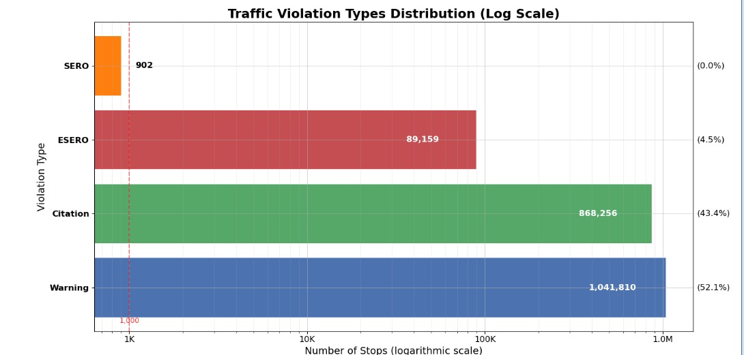
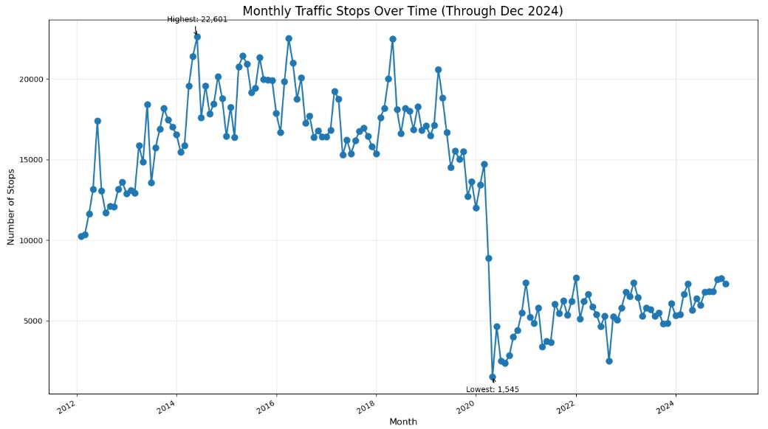
Exploratory Data Analysis
Categorical Variables:
Warnings are the most frequent type of traffic violation, accounting for over half of all stops.
Citations represent the second most common violation, covering roughly 43% of the dataset.
ESERO violations, though much fewer, are specialized enforcement actions linked to specific infractions.
SERO violations are rare, typically involving repair orders for safety equipment, making up a negligible share of total stops.
Notes:
Modified the graph based on changes that is we have on;y 4 types earlier we kept the heading as top 10.

Slide 7
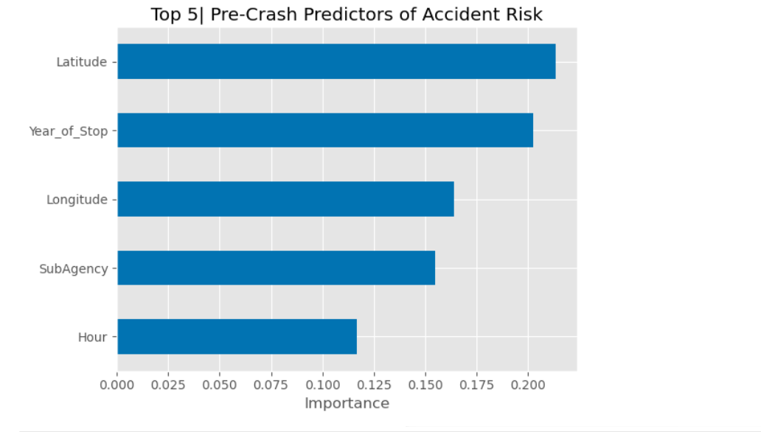
Research questions
1) What are the key factors contributing to traffic accidents in Montgomery County?
We have implemented a Random Forest classifier with 200 trees (max depth 6) and balanced class weights to predict accident risk.
Latitude & Longitude are the strongest predictors, showing that where a stop occurs has the biggest impact on whether it turns into an accident.
Year_of_Stop ranks next, indicating that temporal changes—such as evolving traffic patterns, safety regulations, or reporting practices—play a major role.
SubAgency & Hour follow, meaning both the enforcing agency’s procedures and the time of day (e.g., rush‑hour vs. off‑peak) meaningfully influence accident likelihood.
Alcohol & Work Zone flags have the lowest importance, suggesting these binary indicators contribute less predictive signal compared to spatial and categorical features.
Notes:
We performed grid‐search hyperparameter tuning over the number of trees (100–300), maximum depth (4–10), and feature subsets (“sqrt” vs. “log2”), optimizing for ROC AUC, and selected the configuration with 250 trees, max_depth = 7, and max_features = “sqrt” as it yielded the highest score.

Slide 8
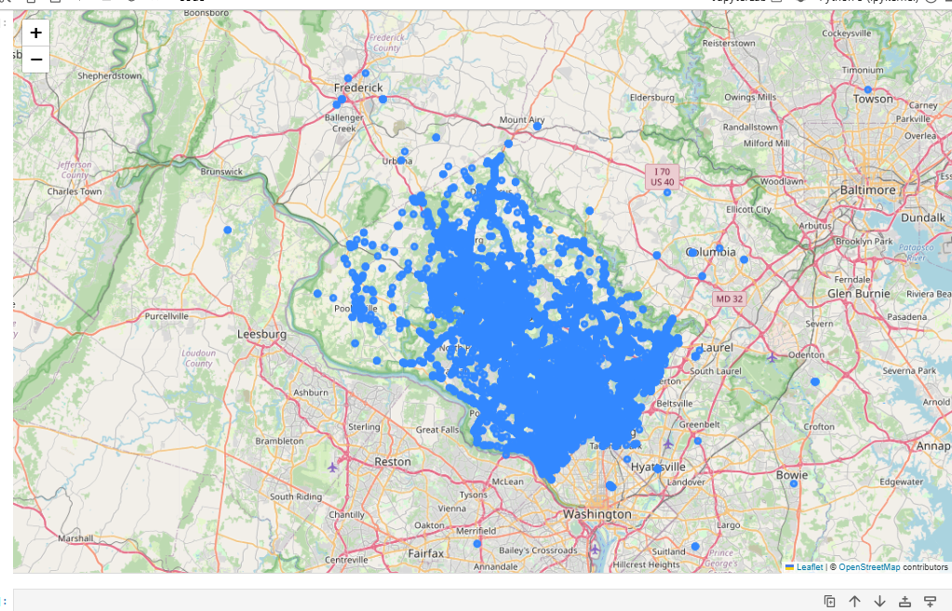
Location
In the image we can see all the accidents in the folium map. Some places have more density of accidents compared to other.
The Southern region seem to have more accidents compared to other regions in the Montgomery city.
These patterns suggest that certain property types are more selectively listed or in higher demand.

Slide 9
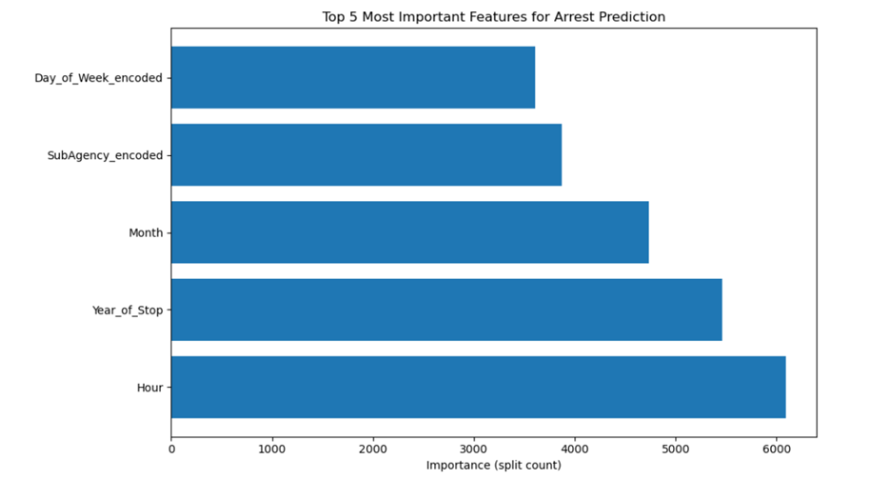
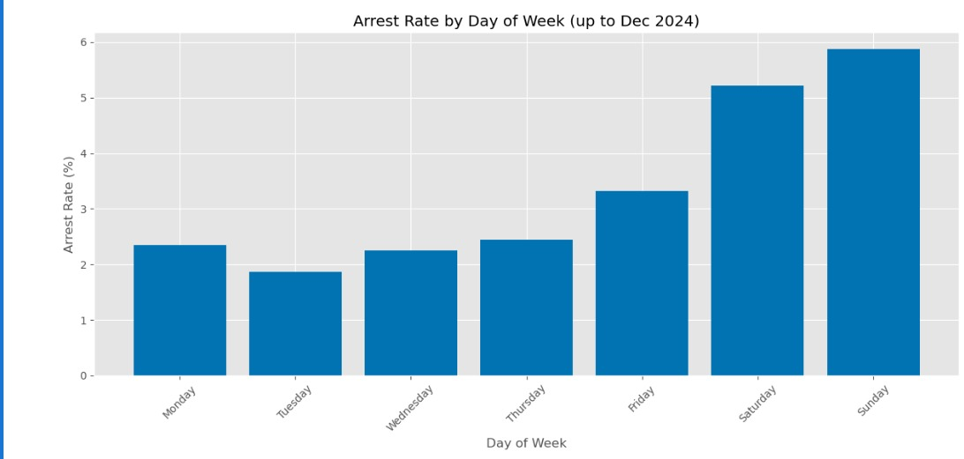
2. Can we predict the likelihood of an arrest based on traffic stop data?
We have implemented Light GBM model to understand the key factors that predict likelihood of arrest.
The top predictors of arrests include Hour, Year of Stop, and Month, emphasizing the influence of time-related features in arrest likelihood.
Based on the graph Arrest Rate by Day of Week we can infer following insights
Arrest rates are highest on weekends, peaking on Sunday, followed by Saturday, indicating increased enforcement or violations during those days.
Weekdays show significantly lower arrest rates, with Tuesday recording the lowest , suggesting different traffic behavior or policing patterns during the workweek.

Slide 10
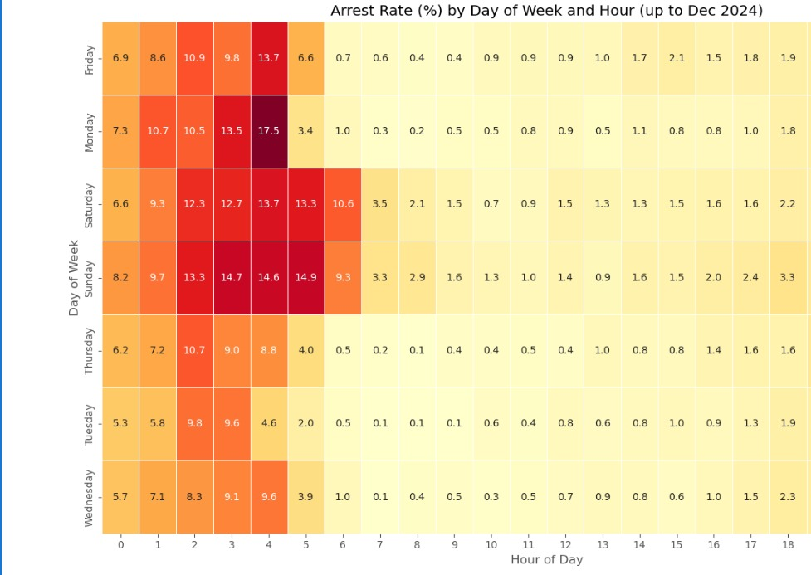
Hourly arrest patterns show that early morning hours (1 AM – 5 AM), especially on Sundays, record the highest arrest rates, indicating a spike in incidents during late-night weekend hours.

Slide 11
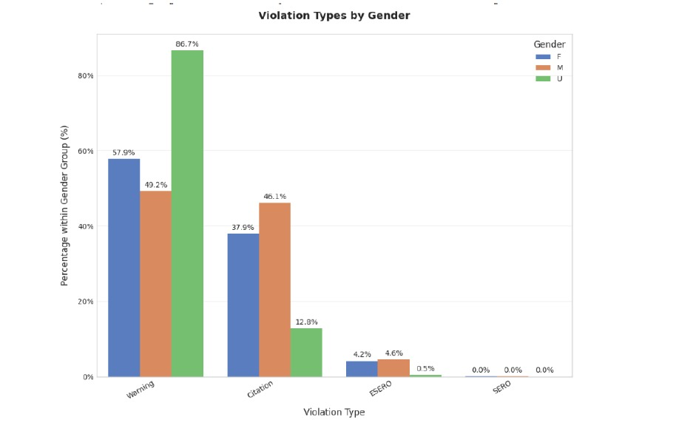
3. How do traffic violations vary across different demographic groups in Montgomery County?
The graphic shows how different violation types are distributed across genders: Female, Male, and Unknown.
Women tend to receive a higher percentage of Warning violations compared to men.
Men have a different pattern, likely receiving more of other types like Citations or ESERO violations.
Overall, there are clear gender-based differences in the kinds of traffic violations issued.

Slide 12
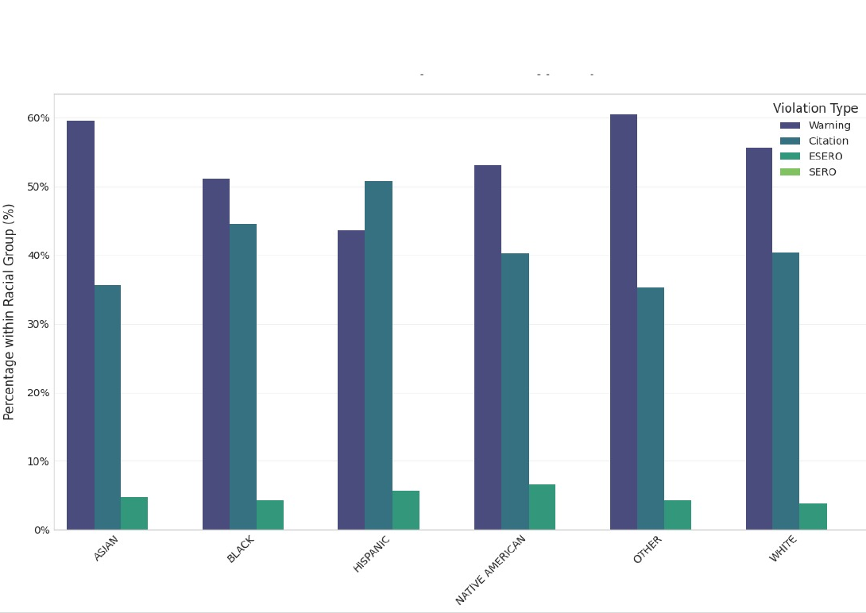
Asian and Other racial groups receive the highest percentage of Warning violations, both close to or above 60%.
Hispanic individuals receive more Citations than Warnings, with over 50% of violations being Citations, unlike most other racial groups.

Slide 13
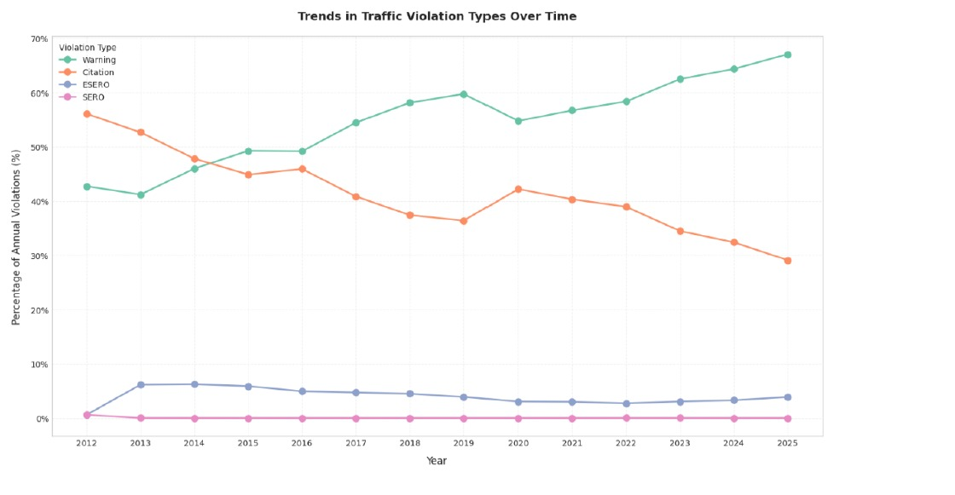
4. What is the relationship between time, date and type of traffic violations issued?
Warning violations have steadily increased from around 43% in 2012 to nearly 67% by 2025.
Citation violations have significantly decreased from about 56% in 2012 to 29% in 2025.
ESERO violations have remained fairly stable, hovering around 6-8% over the years.
SERO violations are consistently low, staying close to 1% throughout the period.
The data shows a clear shift towards more warnings being issued over time, while citations are becoming less common.

Slide 14
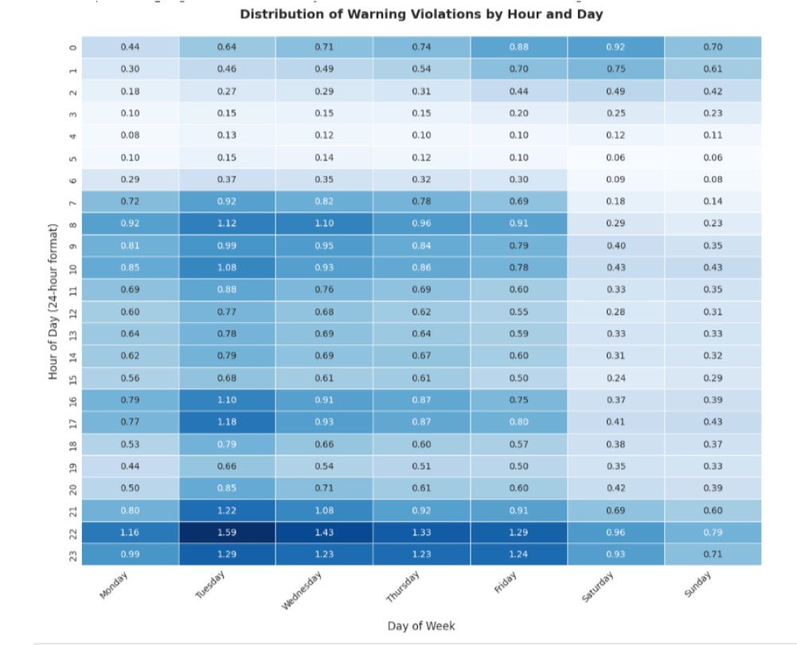
Late evening hours (22:00 - 23:59), especially on Tuesdays and Wednesdays, show the highest percentage of warning violations, peaking around 1.59%.
Early morning hours (00:00 - 06:00) have the lowest incidence of warning violations across all days, typically below 0.5%.

Slide 15

Models:
Random Forest Accident‑Risk Predictor
This algorithm is an ensemble of decision trees that splits on features to minimize impurity, aggregating across 200 trees (max depth 6) to predict whether a stop leads to an accident.
Key Inputs: Hour, Latitude/Longitude, Alcohol & Work Zone flags, plus label‑encoded Day of Week, Month, Year of Stop, SubAgency, VehicleType, Race, and Gender.
LightGBM Arrest‑Probability Classifier
Algorithm: A gradient‑boosted trees model (GBDT) that sequentially fits 1,000 small trees to optimize AUC for predicting arrest likelihood.
Key Inputs: Time/demographic features (Hour, encoded Day of Week, Month, Year), plus 11 binary flags (e.g. Accident, Belts, Alcohol, HAZMAT, Search Conducted).
Evaluation & Insight: We have used metrics F1score,precision,recall score to evaluate.
Notes:
We compared other ml models but these models seem to be best even after running other ml models

Slide 16
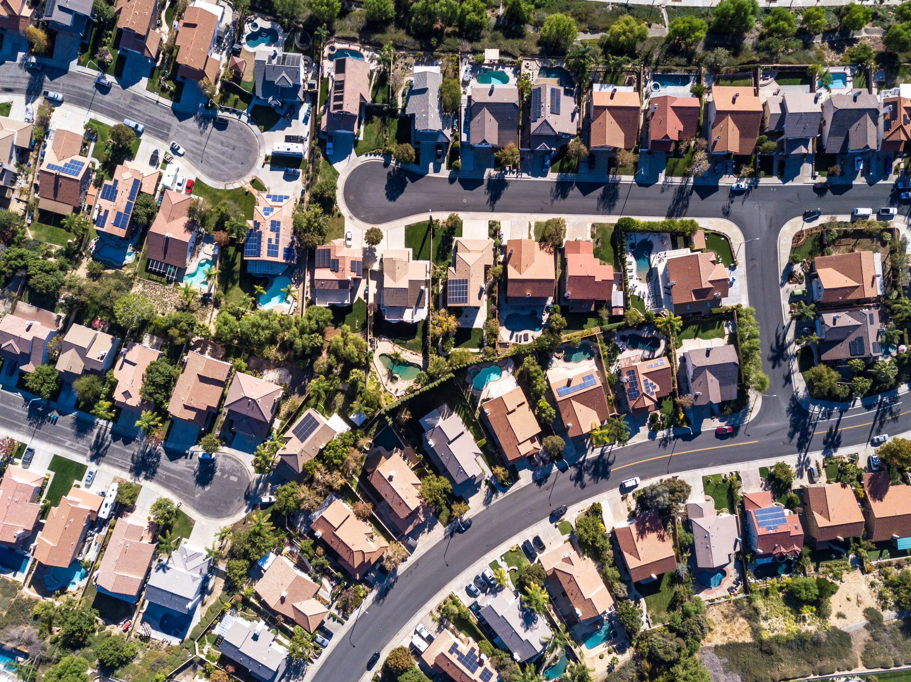
Discussion:
Traffic violations like citations have a higher correlation with accident rates, while warnings are the most common but less severe.
The time of day is crucial: peak accidents and violations occur during specific hours (warnings at 10:00 PM).
Demographic patterns: Race and gender significantly influence the type of violation received. For example, women are more likely to get warnings, while men get more citations.
Violations show strong temporal patterns, varying significantly by day of the week and month. Less violations recorded on weekends suggest enforcement or data recording anomalies.
Conclusion:
Over 2 million records were analyzed using Chi-square tests and predictive modeling to find meaningful patterns in violations.
Violation type and timing (hour, day, month) are the most influential in predicting accidents, more than demographics.
Key Insight: Enforcement strategies and policies can be optimized by focusing on high-risk times and violations, with potential for fairer, data-driven traffic management.

Slide 17

Thank You!!!

